Slide 1

Competition-Based Pizza Parlor Location Recommendation

Slide 2
Business Problem
The location of a business venture is one of the most important factors its success. Location encompasses:
Composition of the neighborhood/locale
Location accessibility from major roads, bus stops, and highways
Competition in the area
This project aims to recommend the best places in Staten Island, NY for a prospective pizza place owner to open a shop.
The scope of this project will include analyzing the concentration of other pizza parlors, Italian restaurants, and general restaurants in the neighborhood to better understand the local competition
Other factors will be out of scope for this project

Slide 3
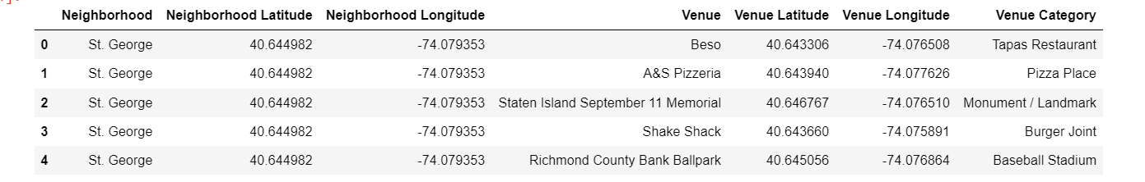
Data
Neighborhood data will be obtained from the NY neighborhood dataset provided on the Coursera Skills Network
Attributes of relevance are borough, neighborhood, latitude, and longitude
Foursquare data obtained via API calls will be used to identify all venues located in Staten Island, NY
Attributes of relevance include venue name, venue category, and geographical coordinates
Foursquare and neighborhood data will be concatenated to assign venues to their neighborhoods as pictured:
Obtained from FourSquare and Coursera

Slide 4
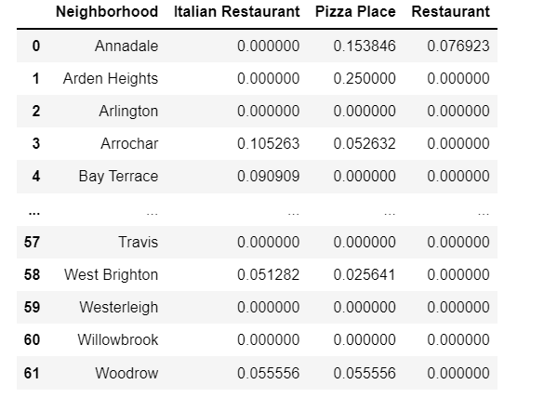
Venue Frequency By Neighborhood

Slide 5
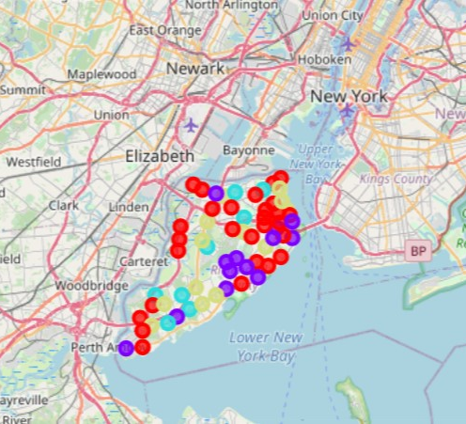
Clustered Neighborhoods
Cluster 0: Red
Cluster 1: Purple
Cluster 2: Teal
Cluster 3: Light Green

Slide 6
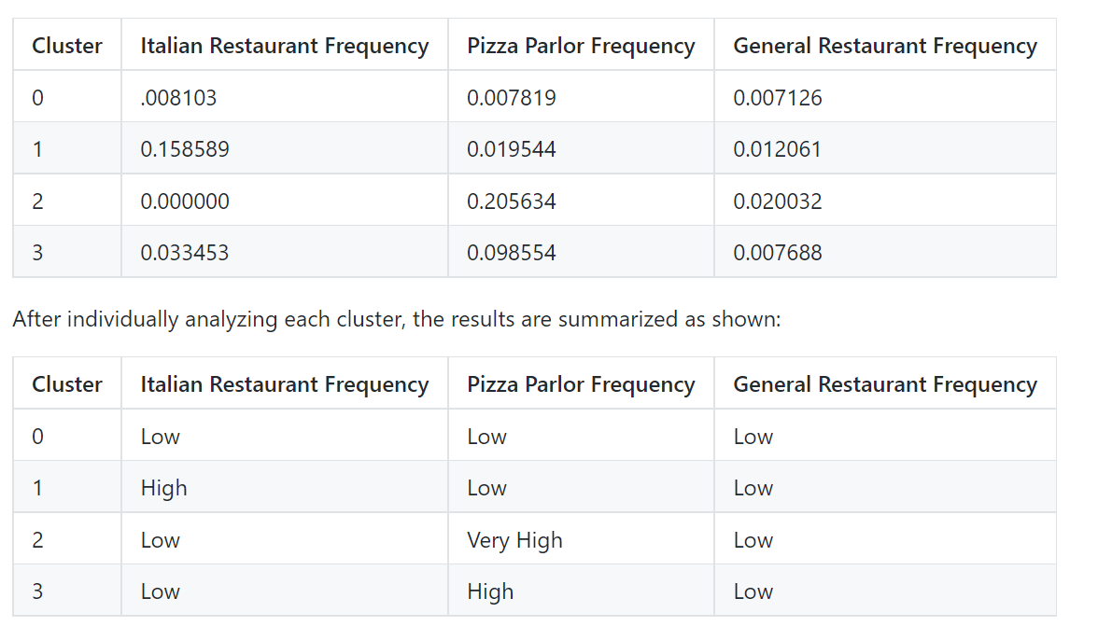
Results

Slide 7
Conclusions
Cluster 0:
Lowest amount of competition due to low concentrations of restaurants in general
On island outskirts/suburbs
Cluster 1:
Moderate competition due to many Italian restaurants
Primarily on north-east of island
Cluster 2:
Highest competition due to high concentration of pizza parlors
In island center
Cluster 3:
Moderate competition due to many Italian restaurants
Further towards island center and south

Slide 8
Recommendation
Based on the assumption that competition is the driving factor in determining location:
Build a customer base a further away from the island center
Avoid high levels of competition
Avoid saturated market
The prospective pizza parlor should be opened in the suburbs of Staten Island
Open a pizza parlor in Cluster 0 on the northern outskirts of Staten Island

